Slide 1

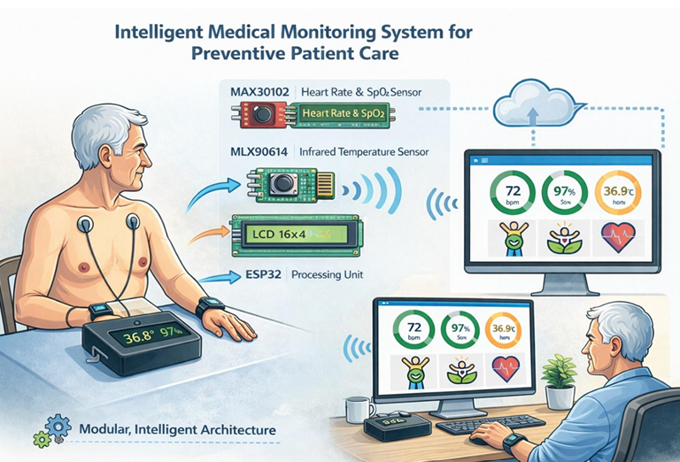

PAGE 01 / 10
PRIVATE HIGHER SCHOOL OF ENGINEERING AND TECHNOLOGY
MAJOR: ELECTROMECHANICAL ENGINEERING
|
SPECIALIZATION: MECHATRONICS
Intelligent Medical Monitoring System
for Preventive Patient Care
PREPARED BY
Hani Khedhiri
Omar Mejri
SUPERVISED BY
Professor Imen Saidi
Ghassen Ben Salem
Yahia Jbeli
Ala Eddine Chibouni
Aymen Badereddine
ACADEMIC YEAR
Mahjoub Henchi
2025 — 2026

Slide 2


















PAGE 02 / 10
Project Overview & Technical Domain
KEY BIOMETRIC FOCUS
Intelligent Embedded Solutions
This project focuses on **intelligent embedded systems** for preventive healthcare monitoring using connected devices to enable continuous, automated monitoring in domestic environments.
Cardiovascular
Heart Rate
Body Heat
Smart Home Integration
Embedded Processing
Temperature
Optimized for daily use without lifestyle disruption.
Real-time analysis via an intelligent processing unit.
Respiratory
Oxygen Saturation
Preventive & Proactive Care
Wireless Telemonitoring
Reduced Hospital Burden

Slide 3


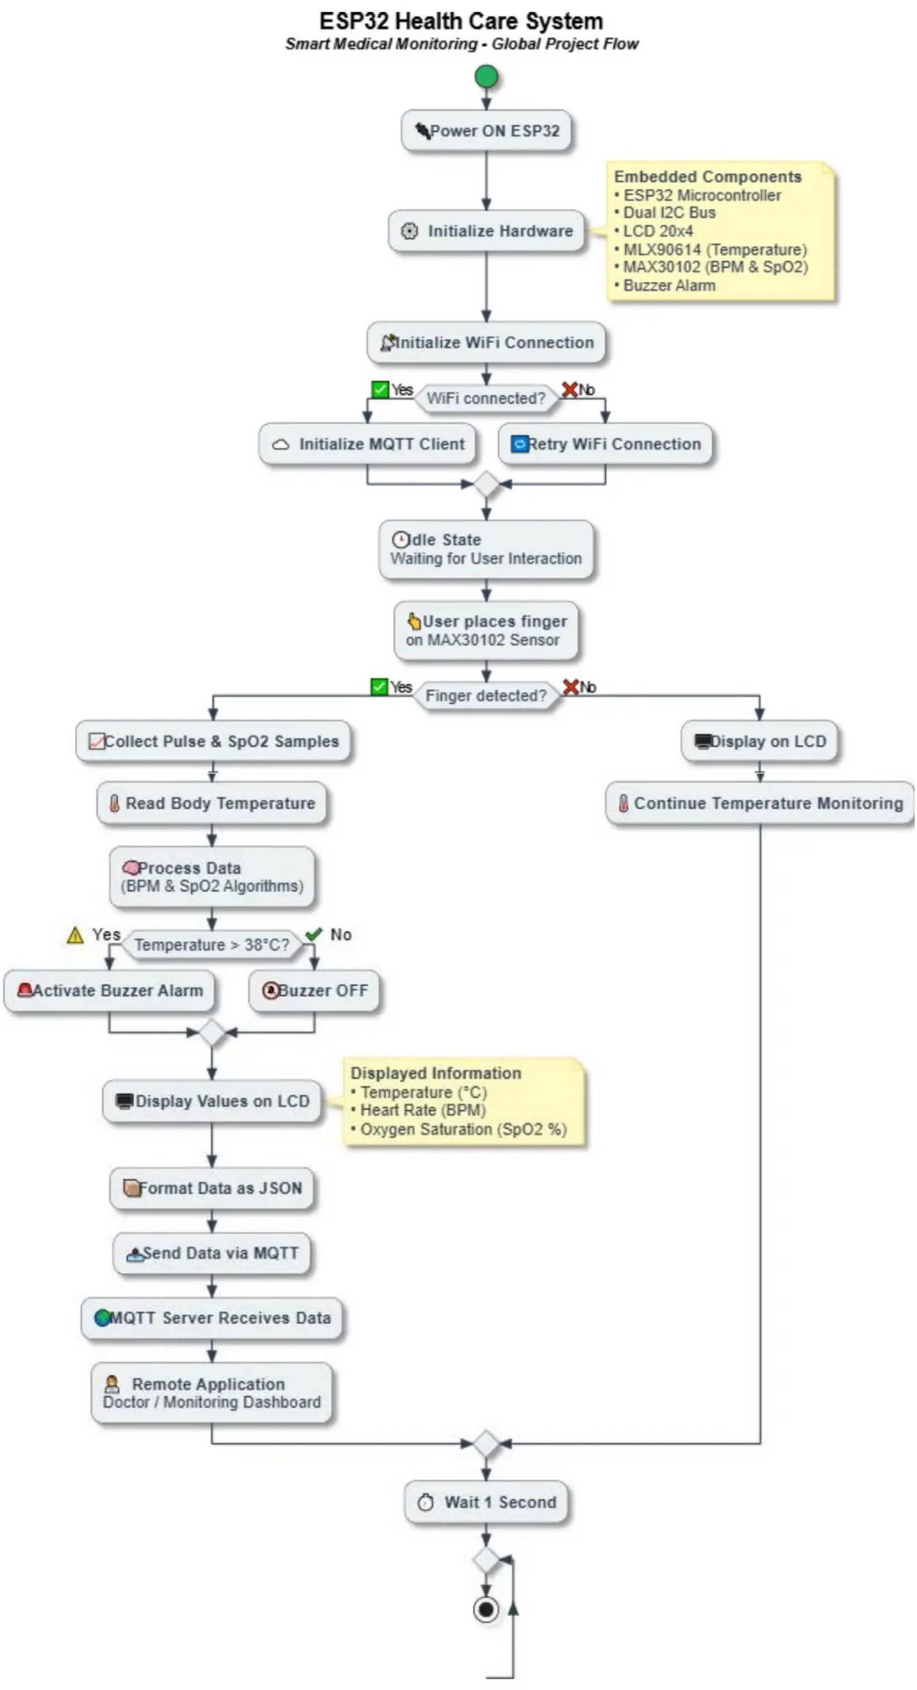








<
PROJECT FLOW DIAGRAM
PAGE 03 / 10
SYSTEM ARCHITECTURE
Core Components & Integrated Ecosystem
HARDWARE & SOFTWARE BLOCKS
Biometric Sensors
Processing Unit
Heart Rate & SpO₂ modules for vital signs.
System "brain" for data analysis.
Display Screen
Audible Alarm
Local visualization of metrics.
Alerts for critical thresholds.
Global project flow from sensor acquisition to remote transmission.

Slide 4

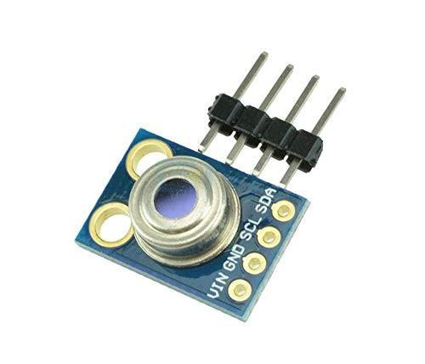
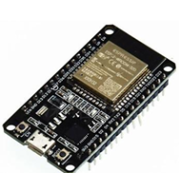
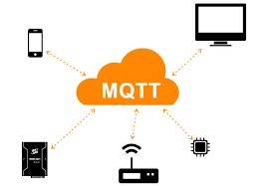

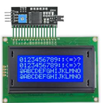
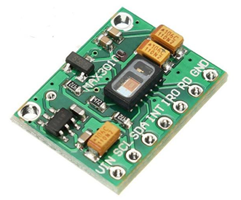









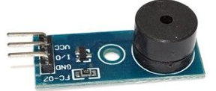






PAGE 04 / 10
CORE FUNCTIONAL BLOCKS
An intelligent modular architecture designed for high scalability and real-time reliability.
Acquisition Block
Processing Block
Communication
Alert & Display
Real-time data analysis
Local Audible Alarms
Anomaly detection
Secure transmission to remote platforms.
Collects real-time biometric data: heart rate, temperature, and SpO2 via embedded sensors.
Visual Screen Display
Medical threshold comparison
WI-FI
BT
MOBILE
Remote App Alerts
INTELLIGENT PROCESSING UNIT
SYSTEM BENEFIT:
Modular approach allows easy addition of new features without affecting existing functions.

Slide 5










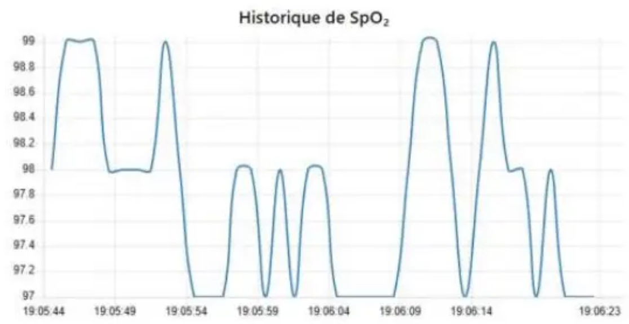

SYSTEM OPERATION
PAGE 05 / 10
Operational Workflow and Data Management
1
2
3
4
Acquisition
Processing
Local Alert
Transmission
Real-time data capture via sensors.
Comparison against medical thresholds.
Immediate alarms for critical values.
Secure data transfer to remote platforms.
PLATFORM VISUALIZATION EXAMPLE
Dual Protection
Synchronized local and remote monitoring ensures health status remains visible and actionable even when users are away.
Immediate response to emergencies
Long-term trend analysis
Continuous Oxygen Saturation History

Slide 6


















State of the Art
PAGE 06 / 10
IDENTIFYING MARKET GAPS & UNMET NEEDS
Fragmented Monitoring
Clinical Overload
High Cost Barriers
Most devices track only one parameter, missing the comprehensive health picture.
Optimized for hospitals; too complex for domestic use by elderly populations.
Expensive hardware and subscription models limit accessibility.
Lack of Integration
Data Privacy Gaps
Portability & Power
Poor communication between measurement and analysis platforms.
Sensitive health information lacks robust security.
Limited battery life restricts continuous 24/7 monitoring.

Slide 7














PAGE 07 / 10
INNOVATION PILLARS
Project Originality & Innovation
Integrated Multi-Sensing
Dual Alert System
Unlike single-parameter devices, we combine Heart Rate, Temperature, and SpO2 into one cohesive biometric ecosystem.
Redundant protection via local audible/visual alarms and simultaneous remote notification to web/mobile platforms.
A comprehensive preventive healthcare platform that transcends the limitations of isolated monitoring devices.
User-Centric Architecture
Modular Scalability
Non-intrusive design optimized for elderly users at home, requiring zero technical expertise for daily operation.
Designed with future-proof blocks that allow seamless addition of new sensors or features without system redesign.
"Redefining the standard of care through integrated intelligence and user-centric design."

Slide 8












<
TARGET USERS
Primary Beneficiaries & Strategic Partners
PAGE 08 / 10
Individuals & Families
Elderly Living Alone
Chronic Disease Patients
Informal Caregivers
People Living Alone
Healthcare Professionals
General Practitioners
Medical Specialists
Home Nursing Services
Physiotherapists
VALUE PROPOSITION
Institutions & Strategic Partners
"Enabling independent living and proactive health management through a discreet safety net."
Nursing Homes
Insurance Providers
Silver Economy Entities
Public Health Agencies
Safety
Autonomy
PRIMARY GOAL
USER VALUE

Slide 9


















REAL-WORLD SCENARIOS
From reactive care to proactive health management
PAGE 09 / 10
SAFETY NET
CLINICAL USE
PREVENTION
Independent Aging
Chronic Care
Active Lifestyles
Provides non-intrusive safety net for seniors living alone.
Vital tracking for patients with heart or respiratory conditions.
Monitors stress and fatigue levels for working professionals.
Continuous tracking of vitals
Immediate local audible alerts
Simultaneous mobile alerts for family
Long-term trend analysis
Notifications of physiological shifts
Early anomaly detection
Prevents health deterioration
Remote treatment adjustments
Encourages timely rest/consultation
* Transforms worry into actionable info
* Reduces hospital readmissions
* Enables predictive well-being

Slide 10








Descriptive Summary & Future Impact
A smart, modular ecosystem transforming reactive medical care into proactive, continuous health management.
PAGE 10 / 10
Modular System
Empowered Autonomy
Smart-Home Health
Integrates temperature, heart rate, and SpO2 sensors into a single, reliable platform. Its flexible architecture allows for seamless future sensor integration and scalability.
Reduces hospital dependency by enabling secure, non-intrusive monitoring at home. Provides peace of mind for both patients and caregivers through real-time remote access.
Advances the "Silver Economy" and digital medicine trends. Contributes to predictive healthcare by identifying early anomalies before they become critical.
"Contributing to the development of smart home environments focused on user safety and independence."
ACADEMIC PROJECT | 2025 - 2026

